Slide 1
Our Code of Conduct
Both you and your parents must sign this and return it to reception asap
Bits we need to stress are in red here !
All participants must:
Respect all requests and requirements made by members of staff supervising the expedition.
Behave always in a manner which will bring credit to themselves, members of staff and the school.
Co-operate with all members of staff, other members of their expedition group and the general public to make the expedition enjoyable, trouble-free and rewarding.
Be considerate to all adults and other students involved in the expedition.
Be punctual at all times.
Always carry with them the appropriate personal, camping and emergency equipment for the expedition. Staff will not provide oral painkillers to students without verbal parent consent.
Ensure they have sufficient nutrition for the duration of the expedition.
Take great care when using potentially dangerous equipment, particularly stoves and knives.
Never cook in or near a tent and take care with flammable materials.
Always stay within sight of their walking group, unless following recognised emergency procedures.
Abide by the Countryside Code.
Abide by the laws of the country and the requirements and conditions of the Duke of Edinburgh’s Award.
Remain on designated campsites following arrival and until dismissed by staff the following day (except on Gold Expeditions).
Avoid making noise or carrying out other behaviours which might cause annoyance to other people (strictly silence on the campsite between 11pm and 6am).
Not purchase or consume alcohol or any other intoxicating substance, nor smoke for the duration of the visit.
Accept personal responsibility for any belongings, including the one designated mobile phone per group for use in emergencies.
Not bring or use music players or mobile phones throughout the duration of the expedition.
Not contact parents/carers without first informing a member of staff, unless in the case of extreme emergency.
Attend school punctually the following day in correct uniform.
Agree that a full report of any misconduct will be communicated to parents and will result in withdrawal from any further expeditions.

Slide 2
There are 20 conditions for expeditions that DofE says you have to do…here are the ones you can control (we sort out the rest!)
Your own physical effort, without any motorised or outside assistance.
Must be unaccompanied and self-sufficient (no hitchhiking, no shop use, no phones etc).
Must have an aim/purpose (decide based on your route for assessed expeditions)
Must be properly equipped for your expedition – correct kit, food etc.
Completed the required training – today and other sessions are compulsory
Undertaken at least one practice expedition (miss it or don’t complete it, you can’t complete).
You and your team must plan and organise your expedition.
You must do the minimum hours of planned daily activity for your DofE level (for Bronze it is SIX hours, not including time a the campsite).
You should cook and eat a substantial meal each day. (Pot Noodle is NOT substantial!)
You must deliver a presentation after your expedition to complete the section (we do this at the finish line on the assessment).

Slide 3
Navigation and Map Skills
Bronze Award Training
Map and compass skills
Types of maps and when to use them (1:25,000 and 1:50,000)
Map features and grid references, direction and contours
Scale and distance, measuring distance
Setting a map and using a compass
Route planning
Direction, Distance and time
Description of route legs linking two places from the map.
How to write a route card
Producing route cards for your practice expedition

Slide 4
There are TWO types of map you will use
1:50,000
Used to plan routes
Shows a large area
1:25,000
Used while walking
Much more detailed (eg. field boundaries)

Slide 5
Features on OS Maps you need to know
 | 1:50,000 | 1:25,000
Footpath, bridleway
Roads (A, B, Minor roads)
Stream/river
Phonebox
Pub
Woodland
Church
Tracks (untarmacked roads)
Railways (cuttings and embankments)
Bridges
Use the two maps on your table to identify the symbols for each feature above (they aren’t always the same on both types of map !!)

Slide 6
Can you spot….
Use your copy of this map to identify the features then show us
Where is the big hill ?
Where is there a long steep ridge or valley?
How do you know if it’s a ridge of a valley?
Find…
A pub
A campsite
A car park
An area of woodland
A phonebox
A railway
A cutting
An embankment
A bridge
An A-road
A stream
A river

Slide 7
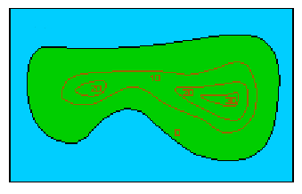
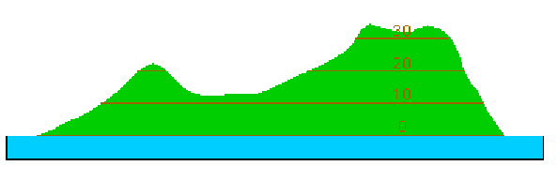
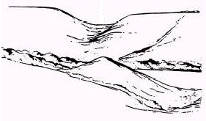
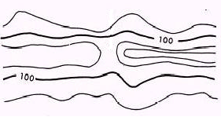
Contour lines !
The closer together the steeper it is (up or down) !!
Numbers on contour lines show height above sea level (that’s how you know if its up or down)
Match them up !
3
2
1

Slide 8
Scale and Distance
A square on both kinds of map is 1km
String is excellent for measuring distance
How far is the route shown in red?
Estimate with your fingers on your map
Then use the string to be more accurate

Slide 9
Grid References and Direction
Eastings and Northings
(E comes before N) “Along the corridor and up the stairs”
You must give SIX FIGURE references for checkpoints and know where you are by grid reference at all times !! (Compass roamers can help you)
1
2
3
4
625333
Lay these scales on your map

Slide 10
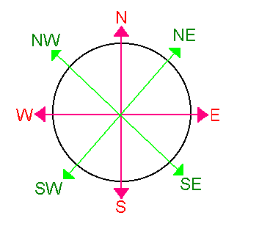
Going from north to south, what are the 6-figure grid references for the 4 circled points ?
You have a copy of this on your table – Write the 4 answers on your sheet
What direction are you travelling from
1 →2 → 3 →4 ?
1
2
At this stage you only need general directions of the 8 cardinal/ intercardinal points but 16 is better !!
3
4
131819
114817
134814
107805
West
East
South West

Slide 11
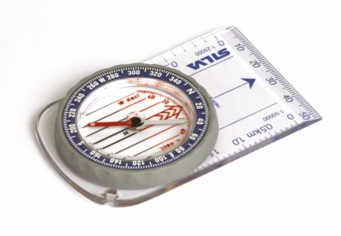
Using a compass !
Setting a map
Lie the compass flat on your palm
Turn your map (and yourself) around until the map faces North

Slide 12
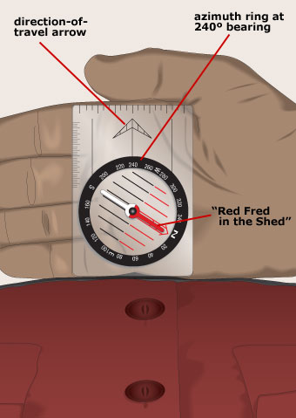
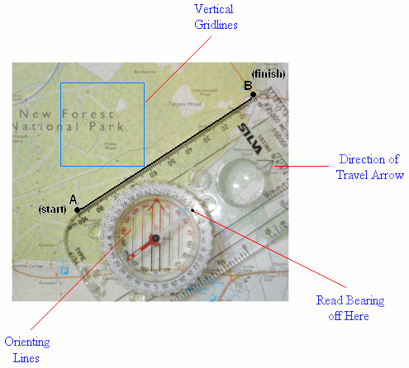
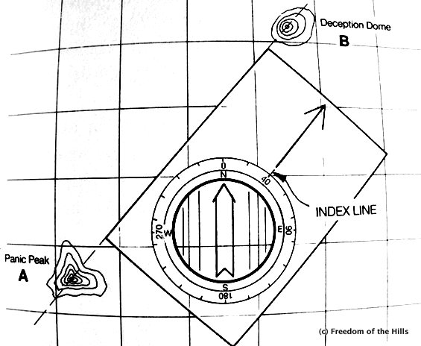
Lay your compass on the map so one edge makes a perfect line from where you are to where you want to be.
Holding the compass in place, turn the dial until the orienting lines are parallel to the north-south lines on the map (don't worry about the needle yet)
Now, you have taken the bearing
What is the bearing from Panic Peak to Deception Dome ?
040
You don’t need the map now to walk on this bearing, just the compass!
Hold your compass flat in your hand and turn your body and compass until RED is in the Shed. You are now facing the direction in which you need to travel.

Slide 13
Route Planning and Route cards
For the practice expedition we will give you a route to follow and you will complete a written route card for each day in a minute.
For the real thing you will have to plan your own route through certain checkpoints and make the route cards for both days electronically – this will be over 2 evenings after your practice expedition – 8th and 9th May
How do you write one? You will see now……
You will be given a route for your group
A- Blue & Pink B-Orange & Green

Slide 14
Bronze Practice Written Route Card
Expedition level: | Day: | Date: | Day number: | Speed in km/h: | Names of team members:
Group number and contact details: |  |  |  |  | Setting out time:
Sat or Sun
28/4/18 or
29/4/18
Write your FULL names here
Bronze
1 of 2 / 2 of 2
3
1-13 (Emergency mobile number)
Mr Withey will tell you !
Leg | Grid reference Start: | Bearing | Distance (km) | Journey time (mins) | Project work/rests (min) | Total leg time (mins) | ETA | Leg description | Escape
1 | To:
2 | To:
3 | To:
4 | To:
5 | To:
6 | To:
Work it out
Split your team into 2 and then you will do a day each.
Fill in the details at the top of each route card
Then get your map out and split your route into small sections (legs) that end at obvious places eg. Junctions, roads, phone boxes - A MAXIMUM OF 6 LEGS
4
Start
6
1
5
End
2
3

Slide 15
Leg | Grid reference Start: | Bearing | Distance (km) | Journey time (mins) | Project work/rests (min) | Total leg time (mins) | ETA | Leg description | Escape
1 | To:
2 | To:
3 | To:
Totals
674342
682321
SE
2.0
40
712330
E
2.5
50
719327
E
1.5
30
6.0
120
Let’s try doing some of this practice route together. Its quicker if you do a column at a time !
Rather than a bearing, just put a compass direction
Use string to work out the distance in kilometres to the nearest half a kilomtere
At 3km/h it takes 20 minutes to walk a kilometre
Start
1
674342
2
3
712330
719327
682321

Slide 16
Leg | Grid reference Start: | Bearing | Distance (km) | Journey time (mins) | Project work/rests (min) | Total leg time (mins) | ETA | Leg description | Escape
1 | To:
2 | To:
3 | To:
Totals
674342
Take footpath SE for 500m then walk E along the road for 1km taking the 2nd path on the righto the church in Stretton
Keep going to church
682321
SE
2.0
40
0
40
9:40
Take footpath E behind the church for 1.5km then take the next path NE, crossing the river until you reach the forest
Return to church
712330
E
2.5
50
15
65
10:45
Follow path SE through the forest for 2km until the A342 main road, follow the road E for 0.5km then take the 3rd path on the left heading NE for 1km
Keep going to A432 or go back to it
719327
E
1.5
30
0
30
11:15
6.0
120
15
135
Decide on how long you want to stop for (not too much), then add it to your journey time for the total leg time – your total for all of the legs needs to be at least 6 hours – 360 minutes
Work out your ETA (Estimated time of arrival) from your start time (I went with 9am but yours might be different)
Leg descriptions are often poor. Describe distance, direction and features in detail
Start
1
674342
2
3
Finally, add escape notes (in case you need help) – go back to last leg end, keep going to next village, leave route and head south to road etc.
712330
719327
682321

Slide 17
Then
Lunch time !
Signs on the lab doors will tell you where to be for the afternoon

Slide 18
Bronze Practice Written Route Card
Expedition level: | Day: | Date: | Day number: | Speed in km/h: | Names of team members:
Group number and contact details: |  |  |  |  | Setting out time:
Leg | Grid reference Start: | Bearing | Distance (km) | Journey time (mins) | Project work/rests (min) | Total leg time (mins) | ETA | Leg description | Escape
1 | To:
2 | To:
3 | To:
4 | To:
5 | To:
6 | To:
Totals

Slide 19
Group | Walking with group on Saturday | Arrival time at car park | Group start time | SATURDAY ROUTE (Day 1) | Arrival Time | SUNDAY ROUTE (Day 2) | Departure time | Finish time
1 |  | 9:00am | 9:30am | BLUE |  | PINK
2 |  | 9:30am | 10:00am | BLUE |  | PINK
3 |  | 10:00am | 10:30am | BLUE |  | PINK
4 |  | 10:15am | 10:45am | BLUE |  | PINK
5 |  | 10:30am | 11:00am | BLUE |  | PINK
6 |  | 11:00am | 11:30am | BLUE |  | PINK
7 |  | 9:00am | 9:30am | ORANGE |  | GREEN
8 |  | 9:30am | 10:00am | ORANGE |  | GREEN
9 |  | 10:00am | 10:30am | ORANGE |  | GREEN
10 |  | 10:15am | 10:45am | ORANGE |  | GREEN
11 |  | 10:30am | 11:00am | ORANGE |  | GREEN
12 |  | 11:00am | 11:30am | ORANGE |  | GREEN

Slide 20
 | 1:50,000 | 1:25,000
Footpath, bridleway
Roads (A, B, Minor roads)
Stream/river
Phonebox
Pub
Woodland
Church
Tracks (untarmacked roads)
Railways (cuttings and embankments)
Bridges
Circle | 6 figure grid reference
1
2
3
4
Directions

Slide 21
Grid Reference and Direction check

Slide 22
Features and Distance
Where is the big hill ?
Where is there a long steep ridge or valley?
How do you know if it’s a ridge of a valley?
Find…
A pub
A campsite
A car park
An area of woodland
A phonebox
A railway
A cutting
An embankment
A bridge
An A-road
A stream
A river
How far is the route shown in red?
Estimate with your fingers on your map
Then use the string to be more accurate

