Slide 1
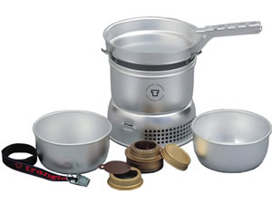
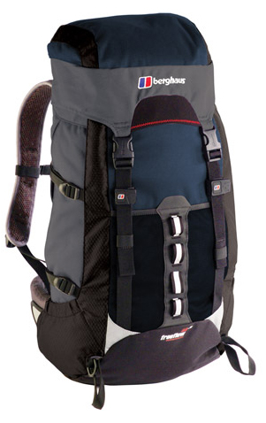
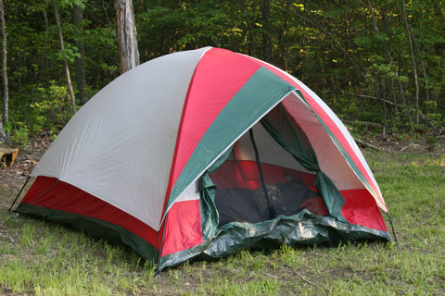
Campcraft – Packing, Kit, Cooking & Food
Bronze Award Training
Kit and Camping
Choosing suitable clothing, footwear and equipment.
How to pack a rucksack
Considerate camping
Choosing suitable food and stoves.
Hygiene, cooking and using/storing fuel safely
Preparing a menu plan

Slide 2
Advice for buying kit
Boots – sturdy and waterproof with ankle support (trainers are OK for Bronze if you have to). Brush off the mud when dry after you get home. Don’t spend a fortune! Comfort is most important.
Walking socks – keep your feet as dry as you can to avoid blisters (flip flops are a good idea for the campsite to air your feet! – no running around in socks on the campsite)
Tents – the cosier the better, make sure you all know how to put it up (and quickly, straight away when you get to camp – it might rain!). 3-man tents usually only sleep 2 comfortably (buy one that is for one more person than you need)
Sleeping bags – stuff them in, don’t roll them – wrap in a TOUGH black bin bag to stay dry. 2-3 season is best!
Kipmat – the only thing that can be attached to the outside of your rucksack (it MUST be in a sealed binbag too! – getting this wet = hypothermia!)

Slide 3
Clothes – Use a layering system to trap air (which will keep you warmer)
Inner layer (T-shirt/synthetic base layer)
Middle layer (fleece/jumper)
Outer layer (waterproof and windproof jacket)
Legs – NO JEANS or thick cotton tracksuit bottoms!! (why?) Synthetic tracksuit bottoms are best or walking trousers (maybe with long-johns underneath?). You must have waterproof over-trousers too.
A hat is essential (to protect you from the sun!)
Ideally, you should have a map case or zip-up plastic wallet to contain your map, route card and compass (there needs to be at least 2 compasses per group).
Rucksack – 55 to 65 litres with lots of outside pockets for easy access to water, food, waterproofs, notepads, pencils etc.
A Head torch is a good investment too, rather than a torch (its hands free!)
https://www.dofeshopping.org/dofe-expedition-kit-list/
This is downloadable (and on our website) and good to tick off what you need, have bought and have packed…..but make sure you have everything on our school kit list at least

Slide 4
We have arranged for representatives from ‘Go Outdoors’ to come to school and show examples of required equipment and provide advice about suitable purchases for expeditions. This will take place in the School Hall on Monday 26th March from 6-7:30pm. There will not be any opportunity to order or purchase equipment on the evening. It is purely a chance for parents and students to seek advice and guidance before spending any money. A 10% discount will be available in-store if students bring proof of their DofE membership.
In Erdington
You can get almost everything
from here !!!
It’s on New Street in Birmingham – YOU GET 10% DISCOUNT WITH YOUR REWARD CARD)
In Tamworth and Birmingham
In Wednesbury
Some recommended brands
(search the internet!!!)
GOOGLE: dofe kit list

Slide 5
Hiring Kit
We can lend you these items for £10 per item and a returnable deposit of £20 per item:
Tents (3-man or 2-man)
Stove & fuel
Sleeping bag
Kipmat
Rucksack
It is advisable that you buy your own equipment really
If you want to hire anything, you need bring the money in an envelope labelled ‘DofE kit hire’ and what you want to hire (CASH ONLY) to Miss Wilson in C3.8.
You will be advised of a time to collect the equipment.
Bronze kit must be ordered by Friday 20th April 2018.

Slide 6
Kit List
Personal kit (other) | Packed
Rucksack and liner (55-65 litre) | Wear !
Sleeping mat
Sleeping bag
Water bottle/Platypus
Knife, fork, spoon
Mug and plate/bowl
Matches (in sealed bag)
Tea towel
Emergency contact card
Maps (and map case)
Compass, route cards
Head torch/Torch and spare batteries
Emergency whistle
Alarm clock/watch
Notebook and pencils
Money
Camera
Bin liners (for keeping things dry and for rubbish)
GROUP:
NAME:
Group Kit | Carried by…. | Packed
Tent inner
Tent outer
Tent poles/pegs
Stove
Pots and pans
Fuel
Washing-up liquid and scourer
String
Personal kit (toiletries/medical) | Packed
Toothbrush and toothpaste
Deodorant
Personal toiletries (including sanitary products)
Small towel
Toilet paper
Sun cream, mosquito repellent
Blister plasters
Plasters
Antiseptic wipes
Paracetamol/aspirin/ibuprofen
Any other personal medication (anti-histamines, inhalers, epi-pen etc.)
Water purification tablets (Gold)
Personal kit (Clothing) | Packed
Walking boots | Wear !
Walking socks (1 per day)
T-shirts/base layers (1 per day)
Fleece top/jumper
Walking trousers (not jeans)
Underwear
Nightwear
Comfy footwear(for campsite)
Shorts, Sunhat (warm weather)
Woolly hat, scarf, gloves (Cold weather)
Waterproof coat/top and trousers
You have a copy of this in your booklet but have a look and ask questions NOW !
The only kit that can be attached to the outside of your rucksack is a sleeping mat, which must be in a waterproof bag
Today you need to decide who is carrying what of your shared kit

Slide 7
Rucksack Challenge
Draw on your rucksack outline where will you put the following items and the rest of your kit:
Tent inner
Clothes
Stove
Water
Food to cook
Pots and pans
Waterproofs
Trail food
Emergency rations
Torch
Toiletries
First aid kit

Slide 8
Rucksack Challenge
Suggestion !
Waterproofs
Notepad, pencils
Camera?
Wearing it:
The hip belt should take most of the weight and should be at the top of the hip bone.
Shoulder straps should be tight-ish, ensuring the rucksack is high and against your back.
Be ‘as one’ with your rucksack
Key Points:
Red sections are easy to access.
Heavy items should be near the top of the main section and close to your back.
Stuff clothes (wrapped in bags around bigger items in the main section)
Use the bathroom scales to see how heavy it is – NO MORE THAN ¼ OF YOUR MASS !!
Keep sharps away from the edge of compartments.
Search ‘How to pack a rucksack’ on Google Videos if you want 10 minutes of even more of this!
Stove, pans, mug
Tent
Torch, emergency rations, first aid kit
Water, Trail food, Lunch
Clothes (separate bags)
Food to cook (non-crushable), cutlery
Sleeping bag (sealed)
Kipmat (sealed and securely strapped to the outside wrapped in a tough binliner)

Slide 9
Considerate & Careful Camping !!!
PITCHING CAMP
Pitch your tent as soon as you arrive (then collapse afterwards!!). If other members of your group aren’t helping with this, get them to fetch some water and start cooking or making cups of tea!!
Tents must be at least 3m from any other tent, so you don’t trip over the guy ropes.
Choose a spot that is on flat ground, sheltered from the wind but NOT under a tree. Position the entrance away from the wind.
Check that pegs will go into the ground easily, and insert them at a 45° angle. Peg out all of the guy ropes in line with the seams.
There should never be any rubbish on the ground outside your tent – use a black bag for rubbish.
NO equipment or clothing should be left outside your tent. Keep everything inside or in the porch.
Make your bed and get out your headtorch before it gets dark.
Don’t wear boots inside your tent and keep the inside clean and tidy.
Don’t let the inner tent touch the flysheet, otherwise it will get wet.
You must be silent between 11pm and 7am.
Don’t go to the toilet on your own.
STRIKING CAMP
Wipe the bottom of your groundsheet dry before you pack it.
Tie up guy ropes and shake water off the flysheet before packing the tent away (hang up tents to dry fully as soon as you get home).
Make sure you check your pitch for any litter – it should be spotless!!

Slide 10
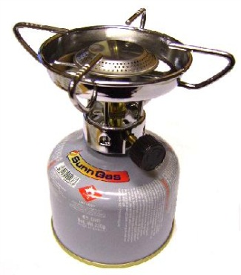
Hygiene and Cooking Safely
It is a good idea to try cooking one of these meals at home first.
Use water from ‘boil in the bag’ meals for washing up or making cup-a-soups.
Use alcohol hand-gel before handling food directly and after you use the toilet.
Clean mugs, cutlery and pans with washing up liquid (in a small bottle - shared) and a scourer in hot water to kill bacteria – do this as soon as you have eaten.
Dirty water should be disposed of onto soft ground away from fresh water.
Put all rubbish into a black bag as you go along.
Meth's bottles need to remain sealed at all times and well away from stoves.
Gas canisters for stoves must be re-sealable (if you buy your own gas stove – IF UNSURE DON’T BUY IT! CHECK WITH US FIRST)
School minibuses have fire extinguishers.
Stoves must be more than 1 metre away from tents (never cook in the porch or have naked flames in the tent)
Check cans have a ring-pull so you don’t need a tin opener.
‘Nesting’ pans are best (ones that fit inside each other)
Use a plastic or tin mug for drinks.
Trangia
Gas Stoves (you have to buy your own gas!!)

Slide 11
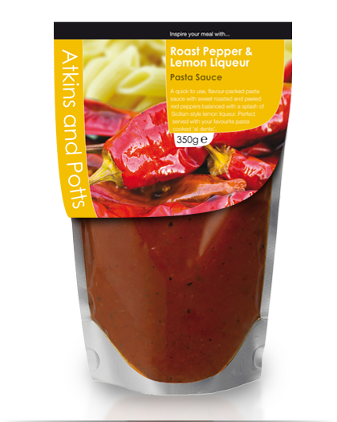
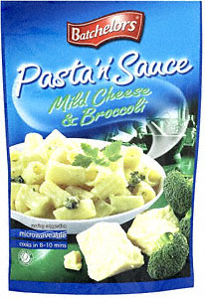
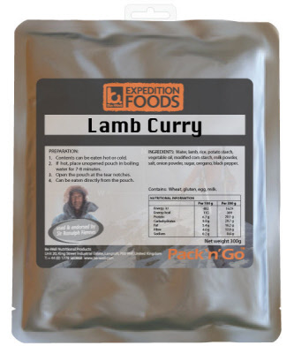
Food choices YES or NO ?
They have NO real nutritional value – a snack not a substantial meal. Supernoodles are just as bad
Good with dried pasta but not in a jar, packets are best
Quick and easy as part cooked
These don’t travel well unless you have a banana case !
Avoid tins if you can, but maybe one for breakfast is ok
OK for 1st day sarnies but easily squashed – pitta bread is better
Ideal for filling pitta breads
Better than pot noodle but you really need to add meat, bread or something else too
The same as bread!
Ideal, easy to cook, no mess and nutritious.. But expensive !!

Slide 12
“Food, Glorious Food”
You must eat regularly for energy and warmth.
What you actually eat is down to personal preference but a sensible diet should be followed as much as possible.
Ideally your choice of food should:
Have a high energy content
A mixture of carbs, protein and fat
Be light and easy to carry (eg packets instead of tins/jars)
Quick and easy to prepare
Tins should have a ring pull to save bringing a tin opener
It is sensible to prepare shared meals (if you can agree) – takes less time, less washing-up and the other group members could be doing other useful things eg. Pitching your tent!
Wayfarer Meals
Expensive (£4.50) but varied and easy to cook.
Look on Amazon !
Try them first – you might hate them!

Slide 13
Menu Ideas (in no particular order)
Breakfast | Lunch | Dinner | Trail Food
Museli/porridge /weetabix with sugar, dried milk and hot water (and dried fruit/chocolate chips). Tea/coffee/ hot chocolate sachet | Filled Baguette, crisps (day 1 only) Carton of fruit juice Flapjacks/ Cake bars | Pasta and sauce with ham and squeezy cheese/cocktail sausages Fruit cocktail in plastic container Coffee/tea/hot choc, sugar, dried milk | Dried fruit & nuts (allergy?) Cereal bars Chocolate bars Flapjacks Pepperami
Foil-packed potato, bacon and onion mix Beans & sausages in a tin | Pitta bread, sandwich paste/ cheese spread, Apple Carton of Ribena | Boil in bag curry, uncle bens part-cooked rice (no need to cook, just add to curry) Wayfarer Treacle Pudding
All-day breakfast in a tin, pitta bread/ fried bread (needs oil) | Bread rolls and corned beef Sausage roll Carton of fruit smoothie | Frozen steak and sausgaes, dried herbs, cous cous. Instant custard
Pancakes and jam/choc spread |  | Tinned mackerel in tomato sauce, Smash/Rissoto
“A hiking friend of mine takes a plastic jar of peanut butter, scoops out about half. To remainder, add honey, chopped dried apricots, chocolate chips, raisins. Mix it all up. Then eat a tsp or two on regular basis on the trail”.
Emergency Rations: Mars bars, glucose tablets, Bottle of cola, Pitta breads, chocolate spread, dried fruit, raw jelly cubes, Kendal mint cake etc. (THESE MUST BE KEPT SEPARATELY AND WILL BE CHECKED AT THE END OF YOUR EXPEDITION)

Slide 14
Menu Plan
GROUP:
NAME:
 | Breakfast | Lunch | Dinner | Trail food
Day 1
Day 2
You will need to fill in a menu plan EACH now using the guidance you have been given
All white boxes must be filled (don’t worry if you don’t bring exactly this menu on the practice)
For the assessed expedition you will need to be more accurate though
Have a look around the supermarket to decide what you will put on this for the assessment !
You then need to write the names of who is carrying what in each ‘tent group’
Emergency rations:
(these will be checked at the end of your expedition)
Group shared Kit | Tent group 1 | Tent group 2 | Tent group 3
Tent inner
Tent outer
Tent poles/pegs
Stove
Pots and pans
Fuel
Washing-up liquid and scourer
String

Slide 15
Staff will now check….
Suitability of your menu
That tents, stoves are evenly spread among group members
Then sign it
You can then take it home

Slide 16
Menu Plan
GROUP:
NAME:
 | Breakfast | Lunch | Dinner | Trail food
Day 1
Day 2
Emergency rations:
(these will be checked at the end of your expedition)
Group shared Kit | Tent group 1 | Tent group 2 | Tent group 3
Tent inner
Tent outer
Tent poles/pegs
Stove
Pots and pans
Fuel
Washing-up liquid and scourer
String

Slide 17
Kit List
Personal kit (other) | Packed
Rucksack and liner (55-65 litre) | Wear !
Sleeping mat
Sleeping bag
Water bottle/Platypus
Knife, fork, spoon
Mug and plate/bowl
Matches (in sealed bag)
Tea towel
Emergency contact card
Maps (and map case)
Compass, route cards
Head torch/Torch and spare batteries
Emergency whistle
Alarm clock/watch
Notebook and pencils
Money
Camera
Bin liners (for keeping things dry and for rubbish)
GROUP:
NAME:
Group Kit | Carried by…. | Packed
Tent inner
Tent outer
Tent poles/pegs
Stove
Pots and pans
Fuel
Washing-up liquid and scourer
String
Personal kit (toiletries/medical) | Packed
Toothbrush and toothpaste
Deodorant
Personal toiletries (including sanitary products)
Small towel
Toilet paper
Sun cream, mosquito repellent
Blister plasters
Plasters
Antiseptic wipes
Paracetamol/aspirin/ibuprofen
Any other personal medication (anti-histamines, inhalers, epi-pen etc.)
Water purification tablets (Gold)
Personal kit (Clothing) | Packed
Walking boots | Wear !
Walking socks (1 per day)
T-shirts/base layers (1 per day)
Fleece top/jumper
Walking trousers (not jeans)
Underwear
Nightwear
Comfy footwear(for campsite)
Shorts, Sunhat (warm weather)
Woolly hat, scarf, gloves (Cold weather)
Waterproof coat/top and trousers
The only kit that can be attached to the outside of your rucksack is a sleeping mat, which must be in a waterproof bag

