Slide 1
Yoga and mindfulness club
Today’s session is about mindful activities you can do at home!
Mindfulness is the state of mind that allows you to be present. It allows you to realize and recognize life as it is. Mindfulness exercises for teens help you achieve just that.

Slide 2
1. Mindful dancing
Duration
You can dance for as long as you want, but aim to go through at least one song.
How to Apply
Turn on a song or a music genre of your choice. Pop, R&B, jazz, make your pick.
Close your eyes.
Listen to your body and dance with the rhythm.
Concentrate on how your body naturally adapts to the music.
Dance through the music and keep your focus only on the music and your moves.

Slide 3
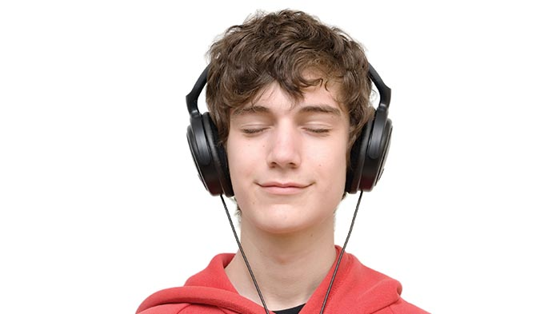
2. Mindful music
Duration
You can apply this creative exercise for as long as you want but if you have other chores to do, giving it 5-10 minutes will be enough.
How to Apply
Instrumental music works best to develop mindfulness, but if you have taste for other genres, that will work as well.
Before starting, tune into your feelings.
As you listen to the music, notice your feelings without any criticism of what they are.
Keep in mind that music affects us whether we want it or not.
Notice how your body reacts to each beat.
When you finish the exercise, think about the feelings that had surfaced.

Slide 4
3. Mindfulness puzzles
How to apply:
Pick a puzzle you want to complete- this could be a crossword or word search, or anything you like!
Start the exercise as usual. As a difference, you should use a pen instead of a pencil.
As you make mistakes that would be hard to erase, think about the emotions that you reflect. Why did you make the mistake, did you rush into it? How frustrated or angry did you get?
When your feelings surface, find a way to make up your mind again with the help of breathing. Keep going.
After finishing the puzzle, think about how you felt through the process and why and how long it took you to get back on track.

Slide 5
4. Mindful tasting
How to Apply
Pick a simple aromatic food. It can be a fruit like strawberry.
Close your eyes, breathe in the scent of the food, see how your mouth waters.
Try to feel the texture. Does it have a bumpy surface or a wet smooth one?
Make sure you focus only on the food and that your mind doesn't wander off in this mindfulness activity. Be present.
Take a small bite of the food. How does it taste? Focus on how you react to it. Do you squint because it’s sour or do you feel heat in your throat because it’s spicy?
Make sure you savor every bit of your bite. When it’s done, go on and take another bite.
Repeat savoring each and every bite till you finish.

